Slide 1
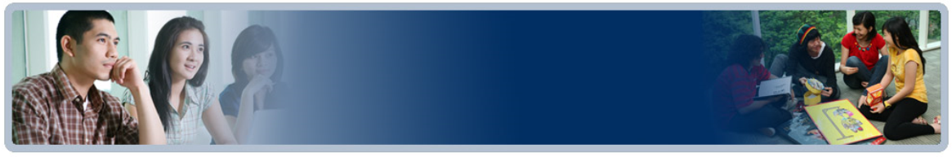

01
Probability and Counting theory
Samuel Lukas

Slide 2
Definition
Experiment
Process with a number of possible outcomes
Trial
One iteration of an experiment – one outcome occurs
Sample space
The set of all possible outcomes in one trial of experiment
Event
Any subset of sample space.
Discrete sample space
if it consists of a finite or countably infinite set of simple events
Continuous sample space
if it consists of an uncountably infinite set of simple events

Slide 3
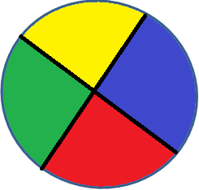
Example 01
A spinner has 4 equal sectors colored yellow, blue, green and red. What are the experiment, possible outcomes, event, sample space. Is it a discrete or continuous sample space ?
The experiment is spinning the spinner.
The possible outcomes are landing on yellow, blue, green or red.
One event of this experiment is landing on blue.
The sample space is = { yellow, blue, green, red }.
It is discrete sample space.

Slide 4
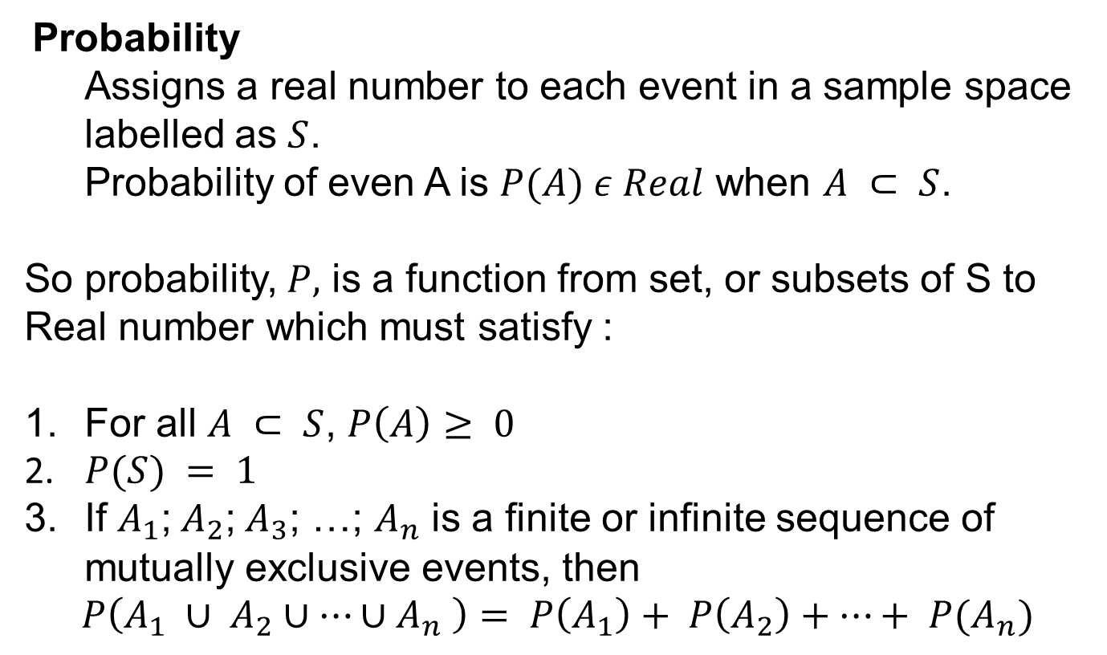
Probability
Probability
Assigns a real number to each event in a sample space labelled as $S$.
Probability of even A is $P(A) ε Real$ when $A ⊂ S$.
So probability, $P,$ is a function from set, or subsets of S to Real number which must satisfy :
For all $A ⊂ S$, $P\left(A\right)≥ 0$
2. $P(S) = 1$
3. If $A_{1}$; $A_{2}$; $A_{3}$; …; $A_{n}$ is a finite or infinite sequence of mutually exclusive events, then
$$P\left(A_{1} ∪ A_{2}∪…∪A_{n} \right)= P\left(A_{1}\right)+ P\left(A_{2}\right)+…+ P(A_{n})$$

Slide 5
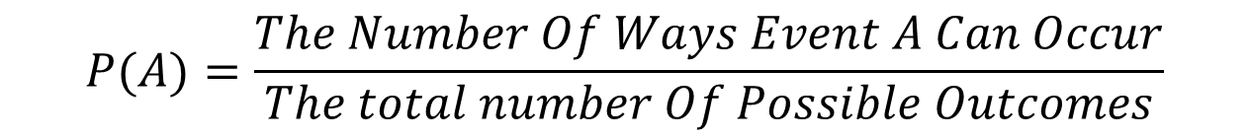
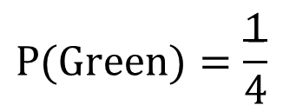
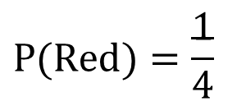
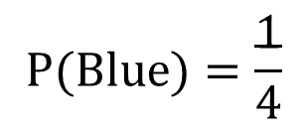
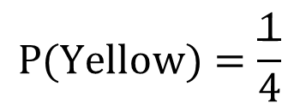
Probability of An Event
$$P(A)=\frac{The Number Of Ways Event A Can Occur}{The total number Of Possible Outcomes}$$
Previous example : Outcomes = {Yellow, Blue, Red, green}
$$P(Yellow)=\frac{1}{4}$$
$$P(Blue)=\frac{1}{4}$$
$$P(Red)=\frac{1}{4}$$
$$P(Green)=\frac{1}{4}$$
The probability of landing on each color of the spinner is always one fourth
Then the outcomes are equally likely to occur.

Slide 6
Exercises 01
Which of the following is an experiment?
A. Tossing a coin.
B. Rolling a single 6-sided die.
C. Choosing a marble from a jar.
D. All of the above.
All of the above.
2. Which of the following is an outcome?
A. Rolling a pair of dice.
B. Landing on red.
C. Choosing 2 marbles from a jar.
D. None of the above.
Landing on red.
Which of the following experiments does NOT have equally likely outcomes?
A. Choose a number at random from 1 to 7.
Toss a coin.
Choose a letter at random from the word SCHOOL.
None of the above.
Choose a letter at random from the word SCHOOL.

Slide 7
Exercises 02
4. What is the probability of choosing a vowel from the alphabet?
A. 21/26. B. 5/26.
C. 1/21. D. None of the above.
5/26.
5. A number from 1 to 11 is chosen at random. What is the probability of choosing an odd number?
A. 1/11. B. 5/11. C. 6/11. D. None of the above.
6/11.
6. A glass jar contains 5 red, 3 blue and 2 green jelly beans. If a jelly bean is chosen at random from the jar, then which of the following is an impossible event?
A. Choosing a red jelly bean.
Choosing a blue jelly bean.
Choosing a yellow jelly bean.
None of the above.
Choosing a yellow jelly bean

Slide 8
Exercises 03
7. A spinner has 7 equal sectors numbered 1 to 7. If you spin the spinner, then which of the following is a certain event?
A. Landing on a number less than 7.
Landing on a number less than 8.
Landing on a number greater than 1.
None of the above.
Landing on a number less than 8.
8. If a single 6-sided die is rolled, then which of the following events is neither certain nor impossible?
A. Landing on a number less than 7.
Landing on an even number.
Landing on a zero.
None of the above.
Landing on an even number.

Slide 9
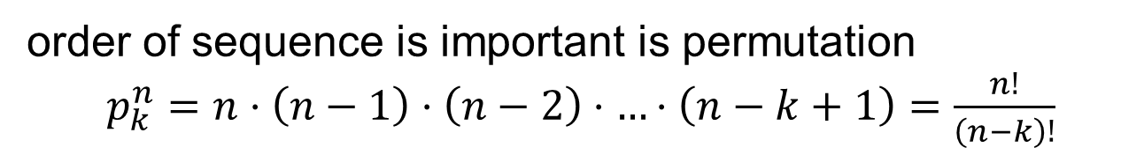
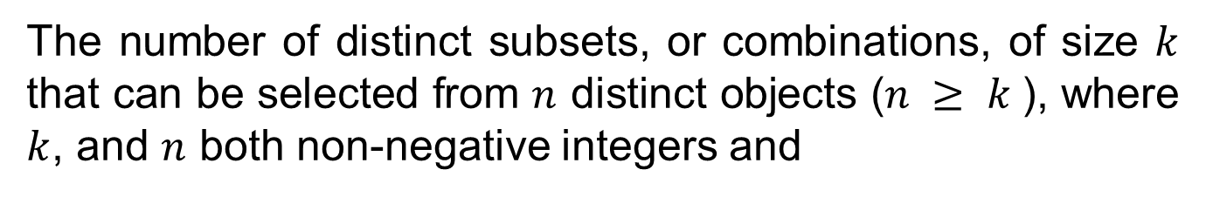

Permutation
The number of distinct subsets, or combinations, of size $k$ that can be selected from $n$ distinct objects ($n ≥ k$), where $k$, and $n$ both non-negative integers and
order of sequence is important is permutation
$p_{k}^{n}=n⋅\left(n−1\right)⋅\left(n−2\right)⋅…⋅\left(n−k+1\right)=\frac{n!}{\left(n−k\right)!}$
order of sequence is not important is combination
$C_{k}^{n}=\frac{n⋅\left(n−1\right)⋅\left(n−2\right)⋅…⋅\left(n−k+1\right)}{k!}=\frac{n!}{\left(n−k\right)!⋅k!}$

Slide 10
Examples 02
If repetitions are not permitted,
how many 3 digit numbers can be formed from 2,3,5,6,7 and 9?.
How many are less then 400?
How many are even
how many are multiples of 5?
$a. x=6⋅5⋅4=120$ numbers
b. $x=2⋅5⋅4=40$ numbers
c. $x=5⋅4⋅2=40$ numbers
d. $x=5⋅4⋅1=20$ numbers

Slide 11
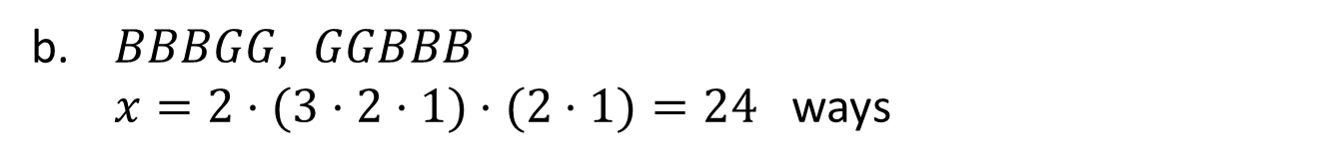
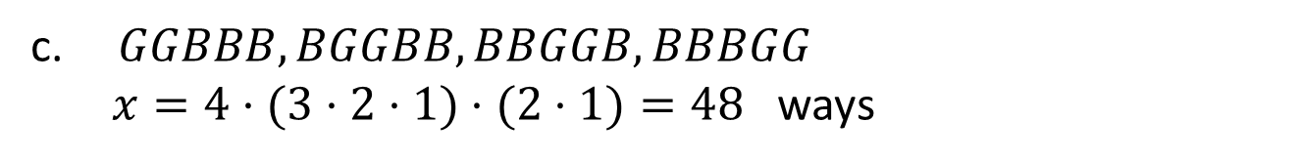
2. a. In how many ways can 3 boys and 2 girls sit in a row ?
b. In how many ways can they sit in a row if the boys and girls are each to sit together ?
c. In how many ways can they sit in a row if just the girls are to sit together ?
$a. x=5⋅4⋅3⋅2⋅1=120$ ways
b. $BBBGG, GGBBB$
$x=2⋅(3⋅2⋅1)⋅(2⋅1)=24$ ways
c. $GGBBB, BGGBB, BBGGB, BBBGG$
$x=4⋅(3⋅2⋅1)⋅(2⋅1)=48$ ways

Slide 12
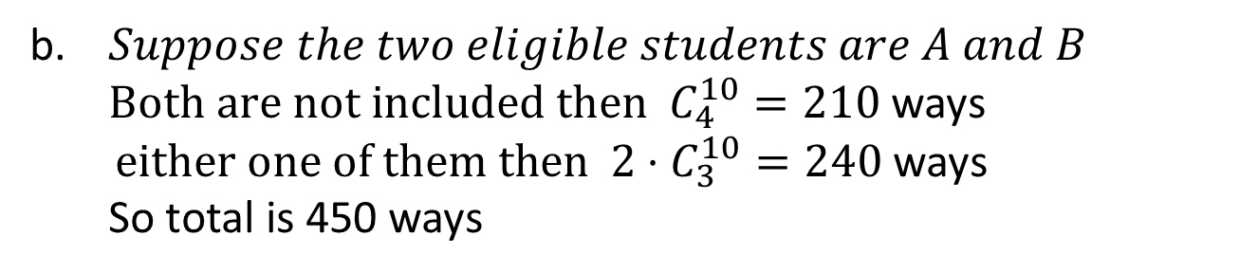
A delegation of 4 students is selected each year from a collage to attend the National Union.
In how many ways can the delegation be chosen if there are 12 eligible students.
In how many ways if two of the eligible students will not attend the meeting together?
In how many ways if two of the eligible students are married and will only attend the meeting together?
$a. C_{4}^{12}=\frac{12!}{8!⋅4!}=495$ ways
b. $Suppose the two eligible students are A and B$
$Both are not included then C_{4}^{10}=210$ways
$either one of them then 2⋅C_{3}^{10}=240$ways
So total is 450 ways
c.${ C}_{4}^{10}+C_{2}^{10}=255 ways$

Slide 13

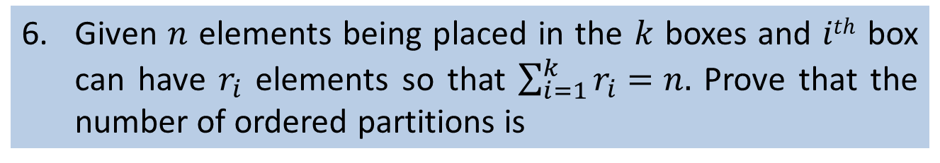
4. In how many ways can 7 toys be divided among 3 children if the youngest gets 3 toys and each of the others get 2 toys?
$x=\frac{7!}{3!⋅2!⋅2!}=210$ ways
5. In how many ways can 12 students be partitioned among 3 teams so that each team has 3, 4 and 5 students?
$x=\frac{12!}{3!⋅(3!⋅4!⋅5!)}=4620$ ways
6. Given $n$ elements being placed in the $k$ boxes and $ith$ box can have $r_{i}$ elements so that $\sum_{i=1}^{k}{r_{i}=n.}$ Prove that the number of ordered partitions is
$$x=\frac{n!}{n_{1}⋅n_{2}!⋅…⋅n_{r}!}$$

Slide 14

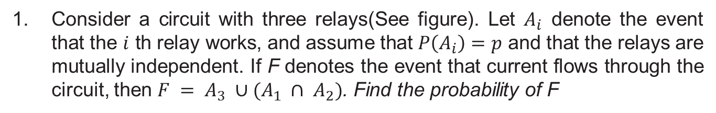


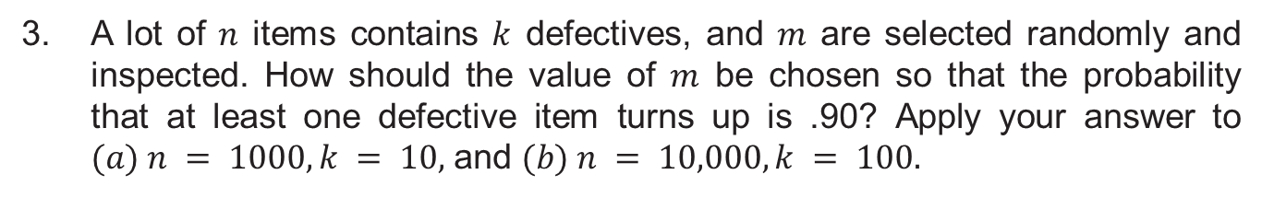
Exercises
1. Consider a circuit with three relays(See figure). Let $A_{i}$ denote the event that the $i$ th relay works, and assume that $P\left(A_{i}\right)=p$ and that the relays are mutually independent. If F denotes the event that current flows through the circuit, then $F = A_{3} ∪(A_{1} ∩ A_{2})$. Find the probability of F
$${P(F)=p+p}^{2}−p^{3}$$
2. How many different letter arrangements can be obtained from the letters of the word statistically, using all the letters?
$$\frac{13!}{2!×3!×2!×2!×2!}$$
3. A lot of $n$ items contains $k$ defectives, and $m$ are selected randomly and inspected. How should the value of $m$ be chosen so that the probability that at least one defective item turns up is .90? Apply your answer to $(a) n = 1000, k = 10,$ and $(b) n = 10,000, k = 100.$

Slide 15
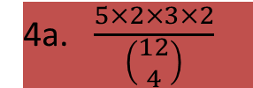

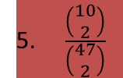
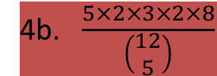
4. A committee consists of five Chicanos, two Asians, three African Americans, and two Caucasians.
a. A subcommittee of four is chosen at random. What is the probability that all the ethnic groups are represented on the subcommittee?
b. Answer the question for part (a) if a subcommittee of five is chosen.
5. A poker player is dealt three spades and two hearts. He discards the two hearts and draws two more cards. What is the probability that he draws two more spades?
6. Six male and six female dancers perform the Virginia reel. This dance requires that they form a line consisting of six male/female pairs. How many such arrangements are there?
4a. $\frac{5×2×3×2}{\left(\begin{matrix}12 \\ 4\end{matrix}\right)}$
4b. $\frac{5×2×3×2×8}{\left(\begin{matrix}12 \\ 5\end{matrix}\right)}$
5. $\frac{\left(\begin{matrix}10 \\ 2\end{matrix}\right)}{\left(\begin{matrix}47 \\ 2\end{matrix}\right)}$
$${6. 6}^{2}×5^{2}{×4}^{2}{×3}^{2}{×2}^{2}$$

Slide 16
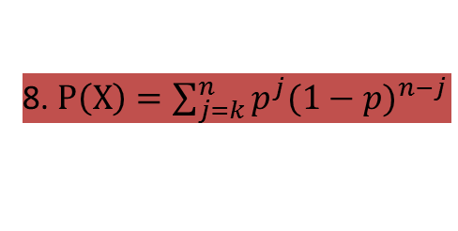



7. A software development company has three jobs to do. Two of the jobs require three programmers, and the other requires four. If the company employs ten programmers, how many different ways are there to assign them to the jobs?
7. $\frac{10!}{3!×3!×4!}$
8. A system has n independent units, each of which fails with probability p. The system fails only if k or more of the units fail. What is the probability that the system fails?
8. $P\left(X\right)=\sum_{j=k}^{n}{p^{j}{(1−p)}^{n−j}}$
9. This problem deals with an elementary aspect of a simple branching process. A population starts with one member; at time t = 1, it either divides with probability p or dies with probability 1 − p. If it divides, then both of its children behave independently with the same two alternatives at time t = 2. What is the probability that there are no members in the third generation? For what value of p is this probability equal to .5?
9a. $P\left(X\right)=p^{3}−2p^{2}+1$
9b. $p=0.597$

